Slide 1

Blockchain Fundamentals: Architecture & Security
Jorden Seet

Slide 2
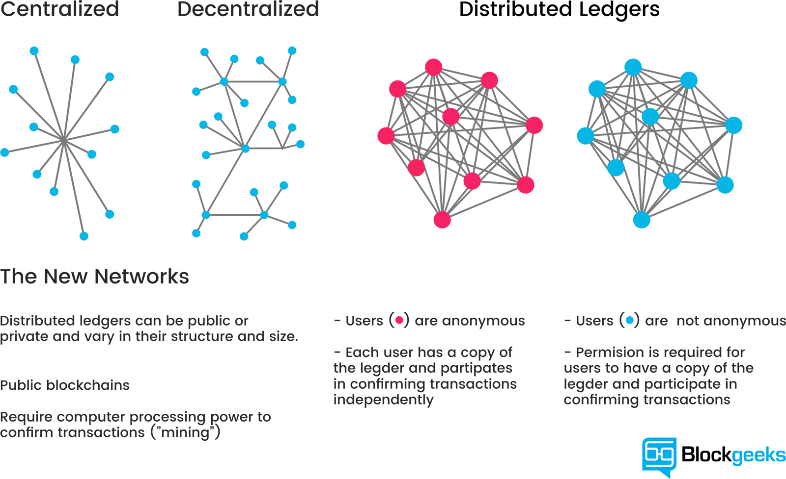



Lesson structure
Dapp Architecture
Blockchain Architecture
Dapp
Security
Blockchain Security

Slide 3
Dapp Architecture

Slide 4
What is a DApp?
Decentralised Application
Not very different from a normal web application

Slide 5

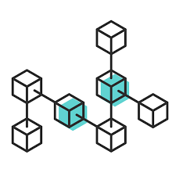


Smart Contract
code
Front-end Interface
Blockchain
Server-side Scripting

Slide 6
Front-end Interface
Interface component
Make the interface pretty and usable
HTML / App.js (React)
CSS
Other libraries like D3.js
Save certain arguments to pass into server-side

Slide 7
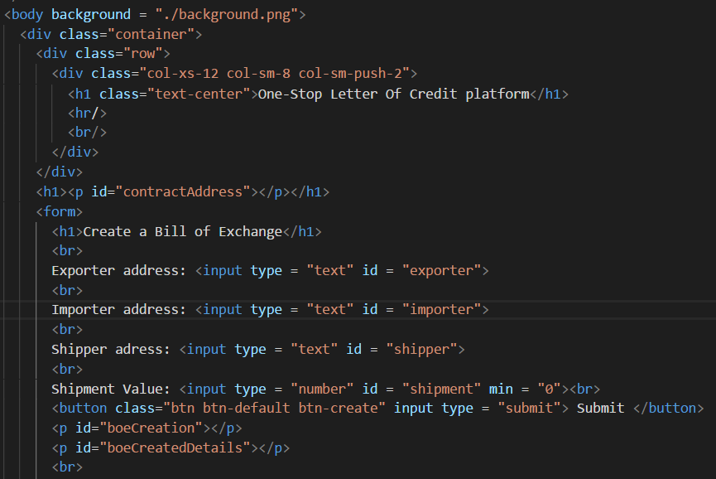
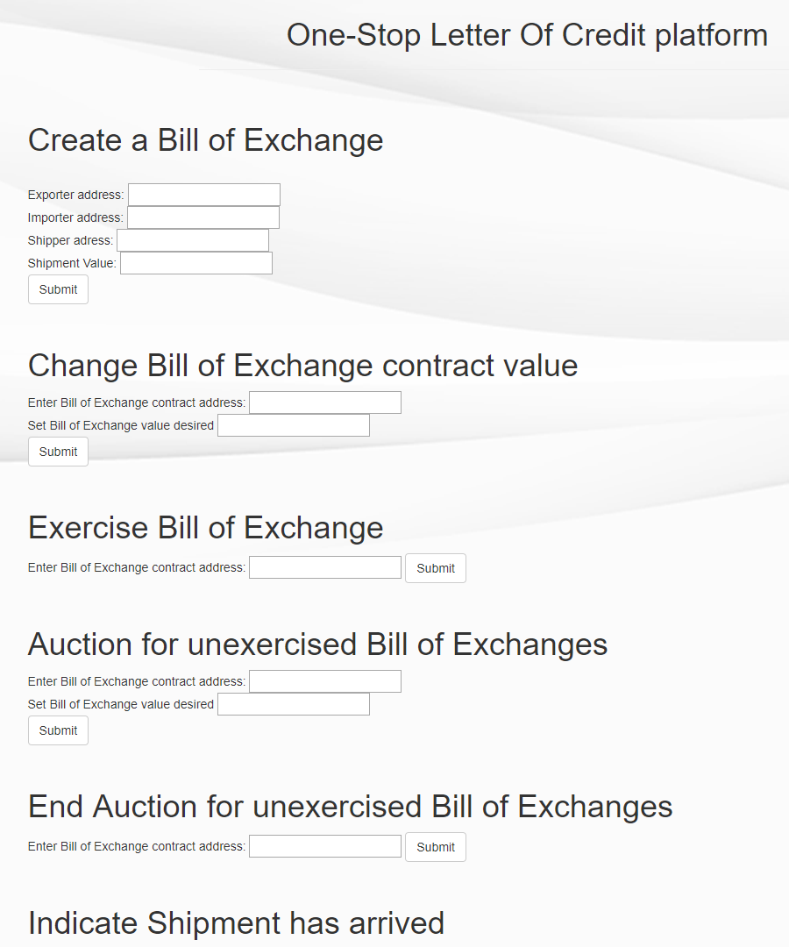
index.html
Webpage

Slide 8
Server-side Scripting
Receives and implement Smart Contract logic
Interacts with front-end and Blockchain
Provides the logic to manipulate passed arguments
Oracles
State Channels

Slide 9




Oracles
Various APIs
Smart Contract
Smart Contract
Server-side Scripting
Customer

Slide 10
State Channels
Stores only end result or essential checkpoints
Ie. Chess results
Smart Contract
Smart Contract
Peer-Peer secure channel
Ie. Chess moves

Slide 11
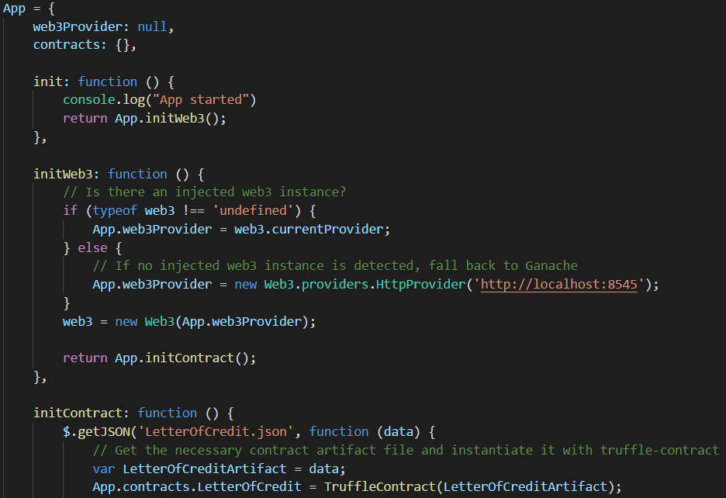
App.js

Slide 12
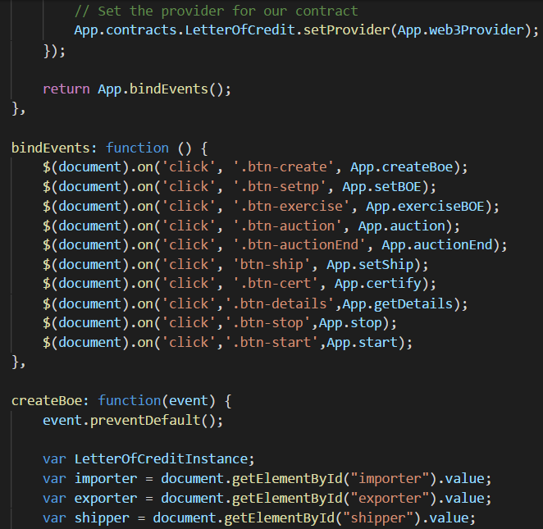
index.html
App.js

Slide 13
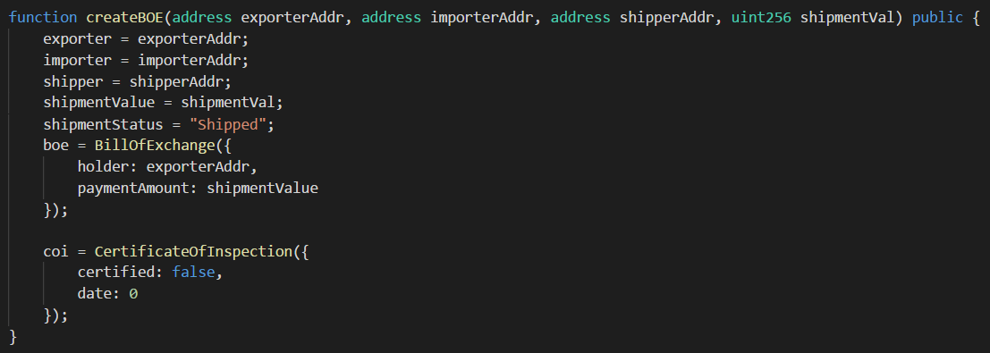
Smart Contract
Smart → Automated by code
Contract → Agreement or Workflow
whatever.sol

Slide 14
Blockchain
Tamper-resistant Database
Distributed Ledger
Append-only
Peer to Peer
No single point of failure
Every node has the same data
Enforced through consensus algorithms

Slide 15
Why do Smart Contracts need the Blockchain?
Smart Contracts require witnesses
Honest nodes operating (anonymously) in a distributed network
Ensure the veracity of transactions done
Verifying signatures, checking for known exploits etc
Nodes may not necessarily be honest
Smart Contracts need a Byzantine Fault Tolerant environment
Consensus must be reached amidst failure of nodes
Ensured (to a higher degree) through the Blockchain

Slide 16
Smart Contract Platform Design
Privacy
Turing-Completedness
Language
Network Bandwidth

Slide 17
Smart Contract Platform Design
Privacy
Is it important to keep certain information private?
Customer Risk scores, publically identifiable information etc
Usage of Cryptographic protocols
Zero Knowledge Proofs – JP Morgan’s Quorum
Channels – Hyperledger Fabric
Uses Cryptographic proofs – computationally expensive
Need to ensure that only used when absolutely necessary

Slide 18
Smart Contract Platform Design
Privacy
Turing-Completedness
Language
Network Bandwidth

Slide 19
Smart Contract Platform Design
Turing-Completedness
The concept that the program can be used to simulate any known algorithm and derive an answer (assuming infinite runtime & memory)
Pros: Can be used to program anything
Cons: Turing-Completedness comes with limiteless attack vectors for bad coding

Slide 20
Smart Contract Platform Design
Privacy
Turing-Completedness
Language
Network Bandwidth

Slide 21
Smart Contract Platform Design
Language
Compilation speed
Java vs Python
Deterministic
Solidity vs C++
Target Audience
Python vs Go
Available Libraries
Solidity vs Rust

Slide 22
Smart Contract Platform Design
Privacy
Turing-Completedness
Language
Network Bandwidth

Slide 23
Smart Contract Platform Design
Network Bandwidth
Smart contract states are stored on the blockchain
Every change in state utilises network computation
If bad/inefficient coding is not penalised, could lead to DoS or bottlenecked speeds
Do we need to penalise such actions?
Private vs Public platforms
Examples: Solidity Gas, EOS RAM

Slide 24



Smart Contract Use-cases
Escrow Peer to Peer Car sharing
Financial Workflows Cross border payments
Supply Chain Automated recording and tracking

Slide 25
Lesson structure
Dapp Architecture
Blockchain Architecture
Dapp
Security
Blockchain Security

Slide 26
Blockchain Architecture

Slide 27

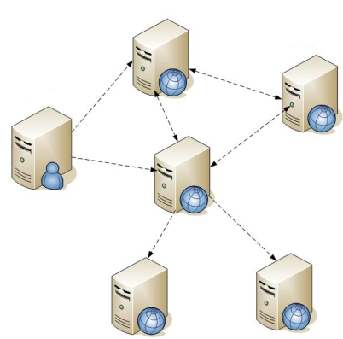

Distributed Ledger
Distributed Messaging
Blockchain
Cryptography
Distributed Computing

Slide 28
Distributed Ledger

Slide 29
Distributed Ledgers
“Advanced” Distributed Databases
What is a Database?
A place that stores data
What is a Distributed Database?

Slide 30


Database
Distributed Database

Slide 31
Distributed Database
Distributed Ledger

Slide 32




WHATS THE DIFFERENCE?

Slide 33
Distributed Database
Distributed Ledger
Operates with assumption that the initial information received is truthful
Operates with assumption that the initial information received is NOT truthful

Slide 34
How can we operate without trusting the information?
This is called the Byzantine Generals Problem
Solving the Byzantine Generals Problem gives us the ability to operate with untrusted information
Byzantine Fault Tolerance

Slide 35
Byzantine Generals Problem
Scenario
Singapore and Malaysia are at War
Malaysia don’t want to supply us water anymore
Singapore war tactic is to slowly conquer parts of Malaysia
Now they facing dilemma over one of the states

Slide 36




Eh, if we conquer KL right, we win alrdy leh

Slide 37
Brother, not so easy la. KL is the capital, confirm got hidden weapon one

Slide 38
This one serious leh, we cannot half-in half-out, half-hearted effort confirm die one

Slide 39
We must decide to whether to all-in or all-out

Slide 40
That’s what she said

Slide 41
Byzantine Generals Problem
The important thing is that consensus must be achieved.
Once the consensus is achieved, the Generals can lead their squad to attack or retreat.

Slide 42
BUT WHAT IF?
There was a traitor?

Slide 43



If I tell Perry and Siow Huang to attack, then tell Ishak to retreat, huat liao GG SG lose most of their army

Slide 44
I can join Malaysia then ez game win SG SG will then come back to Malaysia

Slide 45
Voted Yes
Voted Yes
Go attack
Go attack
Voted No
Mai la don’t geh siao

Slide 46
Byzantine Generals Problem
The solution is that non-traitors must have a majority agreement on their strategy
Assumption: There are more non-traitors than traitors
The only way to achieve that is to check with every other General on their decision, rather than relying on 1 General

Slide 47
Voted Yes
Voted Yes
Voted Yes-Yes
Voted Yes-No
They all know each other’s votes le, can’t bluff them le
Voted Yes-No
Voted No

Slide 48
Before
After

Slide 49
Byzantine Generals Problem
Problem:
This solution works in a permissioned setting, where voters are known and controlled.
What happens in a public setting, where voters are unknown and uncontrolled?
We could have someone create 1000000000 accounts and vote just to gain majority number of votes
This is called a Sybil attack

Slide 50
Byzantine Generals Problem
Solution?
Use probability
Choose a random person inside the voter list to validate the votes
Assumption, more honest voters than dishonest voters
Hence, probability of successful validation of messages >=51%
The more random the selection, the better

Slide 51
Honest
Honest
75% Chance of picking honest voter to validate
Honest
Malicious

Slide 52



Honest
Honest
Honest
Honest
85% Chance of picking honest voter to validate
Honest
Honest
Malicious

Slide 53
Honest
Honest
Malicious
Honest
71% Chance of picking honest voter to validate
Honest
Honest
Malicious

Slide 54
Byzantine Generals Problem
How to deter malicious actors from creating accounts?
Incur a cost when creating an account, or when making transactions
Proof of Work
Punitive measures if found out that malicious
Proof of Stake

Slide 55
Distributed Ledgers Summary
A Distributed Database with Consensus Mechanisms
A Consensus Mechanism is derived from the Consensus Algorithm
Consensus Algorithms are designed based on a variety of factors
Permissioned or Public network?
Nature of participants?
How to achieve randomness?
How scalable should it be?
How secure should it be?
Many others…

Slide 56
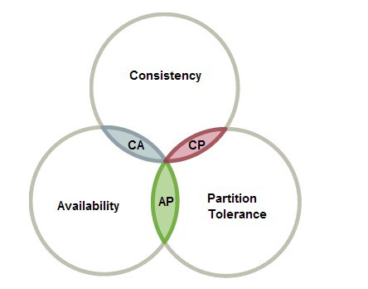
Distributed Ledgers Summary
Consensus Algorithms are designed based on a variety of factors
CAP Theorem
Partition Tolerance is a necessity
Ability of system to run despite message delay
Tradeoffs usually occur between Consistency and Availability
Consistency
All data are consistent at all times
Availability
Ability to get response on request

Slide 57
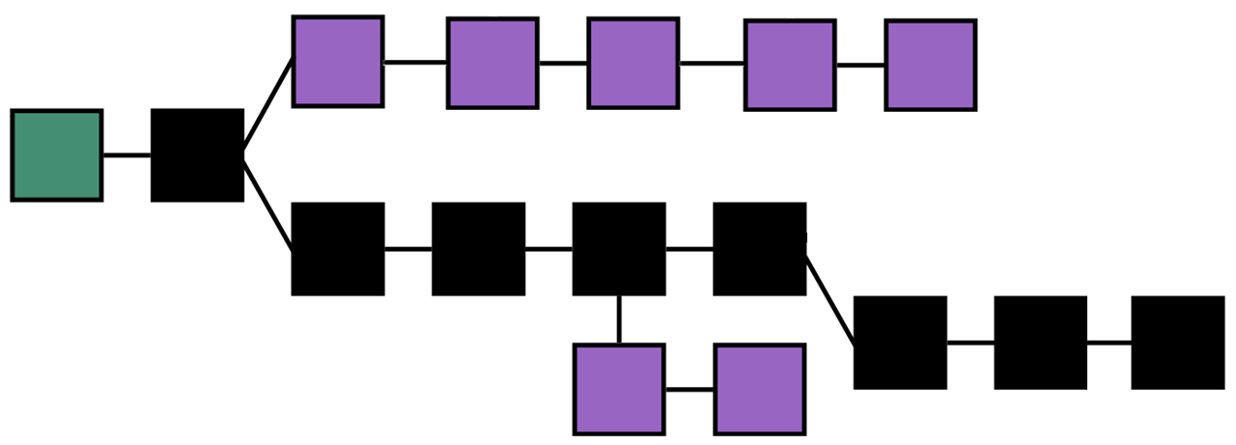
Probabilistic Algorithms
Byzantine Fault Tolerant Algorithms
PBFT, IBFT, HBBFT etc
Every block must have unanimous decision on validity
If >33% different votes, vote again
System can retrieve new txns, but wont validate new blocks
Value Consistency over Availability
Proof of xxxx
Ability to split into multiple chains
Consensus mechanism determined by longest chain
Value Availability over Consistency

Slide 58
Distributed Computing

Slide 59
Distributed Computing
Computing is spread out to multiple computers instead of one
Not just limited to MapReduce
Intranet, World Wide Web, MMORPGs etc
Distributed Databases talks about storage
Distributed Computing talks about computing

Slide 60
Computing
Distributed Computing

Slide 61
Distributed Computing
Blockchain (Or Distributed Ledger Technologies) do not rely on just one computer
Validation of messages/transactions, connection and synchronizing with other nodes is spread across nodes
Different nodes may validate different transactions
Different nodes may connect to different nodes
Necessary for different computations to be processed by different computers
May be too much for one/every computer to handle

Slide 62
Validation of messages/transactions
Question:
How do messages/transactions get validated?
Answer:
Through Cryptography

Slide 63
Cryptography

Slide 64
Cryptography
The first half of Crypto-currency
Primarily consists of two parts:
Hashes
Encryption

Slide 65





Hashes
A one-way function
Takes in an input value, and outputs a value of fixed-length
Deterministic
Same input value ➔ Same output value
Used to make data unreadable

Slide 66
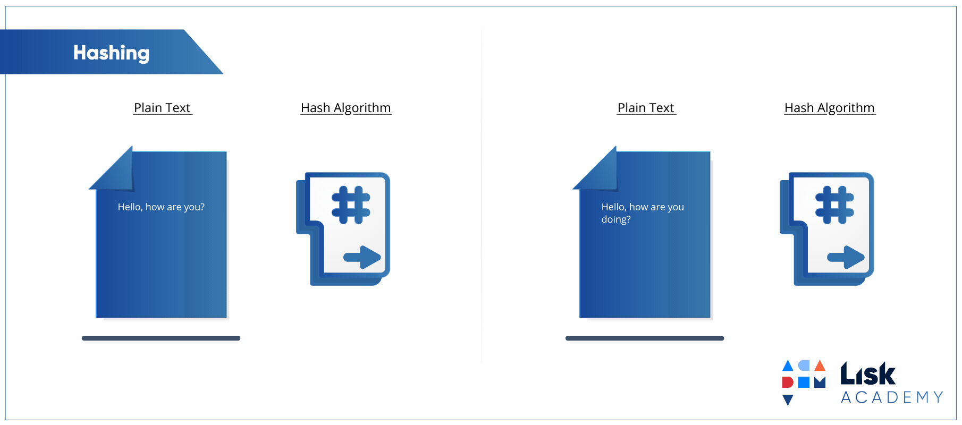
Hashes

Slide 67
Hashes
How are Hashes used in Blockchain?
Unique Identifiers
Transaction Hash, Block Hash
Used to prove data integrity

Slide 68
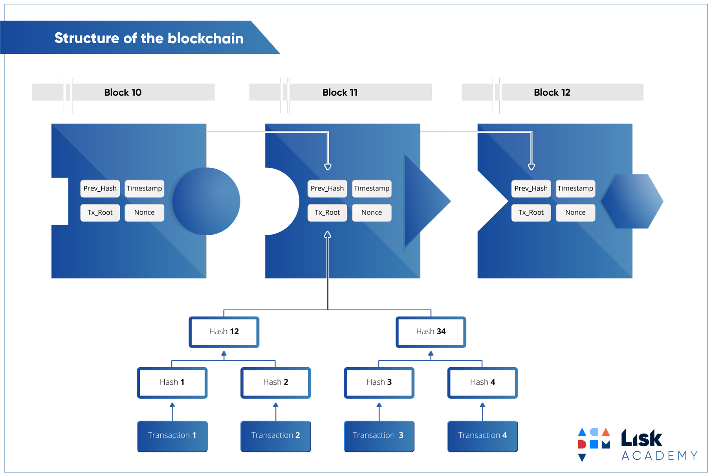
Hashes
Demo

Slide 69
Encryption
Signing Transactions
Single Signatures
Multi Signatures
Cryptographic Proofs
Atomic Swaps
Anonymity
Ring Signatures
Blind Signatures

Slide 70
Encryption
I’m dying already
sf43rr3fe
Encryption
I’m dying already
sf43rr3fe
Decryption

Slide 71
Encryption
Public & Private Keys
Private keys are proofs of identity
Encryption – If a message is encrypted with a private key, it proves that the person who owns the private key signed the message
Decryption – If a message can only be decrypted by a private key, it is only readable by the person who owns the private key
Public keys complement private keys
Mathematically prove non-repudiation of ownership
Non-repudiation → Cannot Deny

Slide 72



Blockchain/DLT Use-cases
Data Integrity Military records, information and communications
IoT/Signal Attestation Consensus against fraudulent signals for Autonomous Vehicles
Digital Identity Prevent citizenship record and identity fraud

Slide 73
Lesson structure
Dapp Architecture
Blockchain Architecture
Dapp
Security
Blockchain Security

Slide 74
Dapp
Security

Slide 75
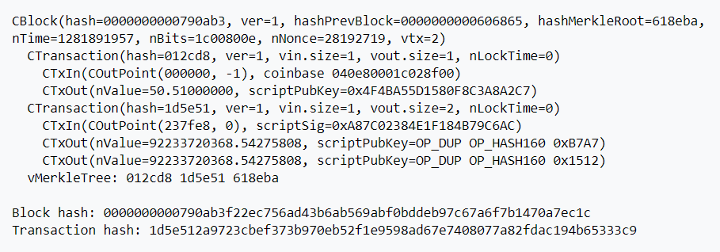
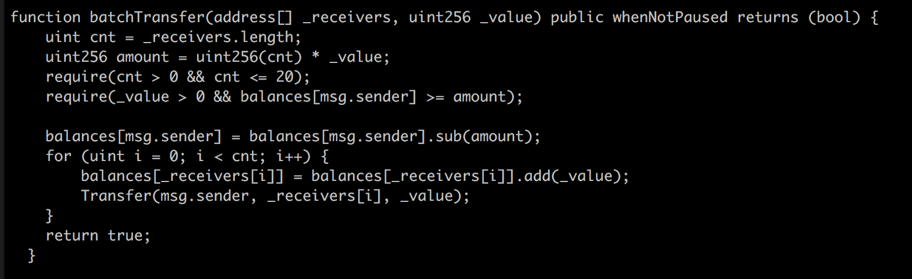
Integer Underflow/Overflow
When one puts in a value that exceeds the limit, the value becomes something else.
Uints have a max value of 2²⁵⁶ – 1, in Solidity it wraps after max value to 0
What happens if we call (2²⁵⁶ )/2 = 8*16^63
with 2 addresses?
92.2 Billion BTC each!
Notes:
Bitcoin Value Overflow
August 2010 → Blockchain eventually forked
Max BTC in circulation → 21 Million

Slide 76
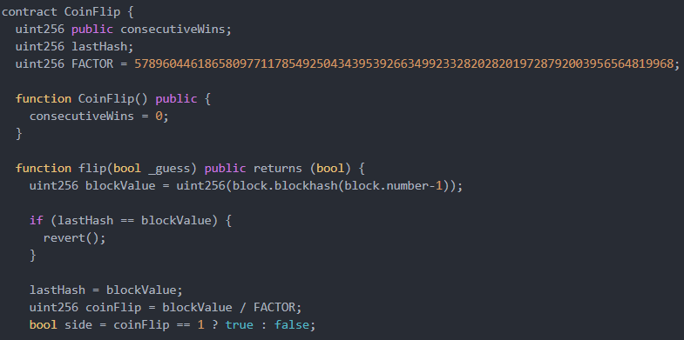
Timestamp Dependence
Dangerous to attempt pseudo-random number generation via block timestamps
Deterministic, attackers can determine the “random” variable

Slide 77
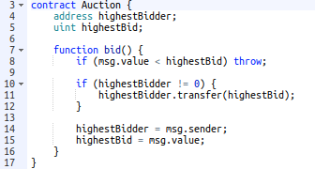
Denial of Service – Smart Contract level
Smart contracts can indicate if they are “payable”
Non-payable functions/contracts cannot receive cryptocurrency

Slide 78
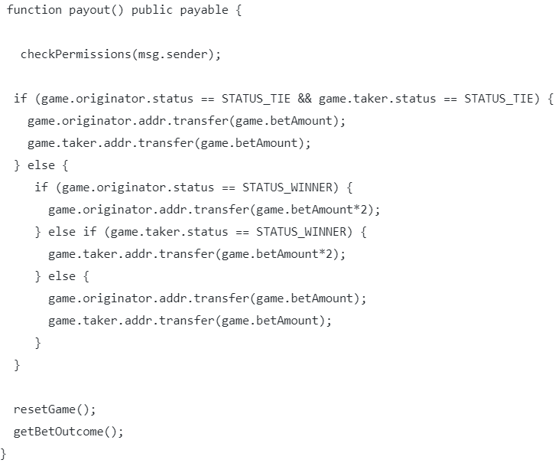
Reentrancy Attack
When a payment is made, it calls the fallback function of the payee contract
The fallback function can call the payment function again recursively
Notes:
Solution: Can set Boolean before transfer or deduct transferable amount from the msg.sender’s balance before the actual transfer
DAO hack →$60m
15% of all Ether

Slide 79
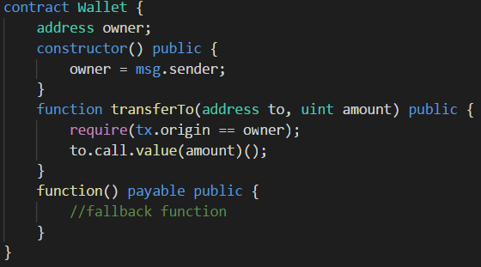
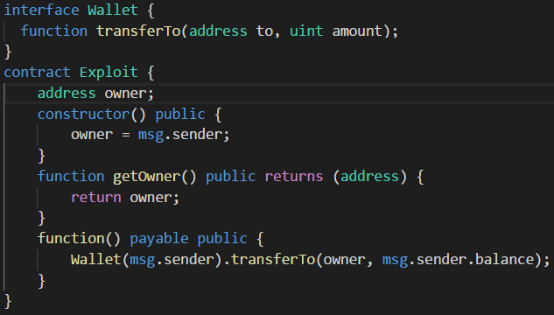
Phishing using tx.origin
Notes:
Wallet is created/used by another individual
Create Exploit contract
Trick victim to send a small amount of cryptocurrency to the Exploit Contract
Fallback function would be activated, and instantiates Wallet(victim)
Because tx.origin will be from the victim, the condition passes and it will send the entire balance of the Wallet to me

Slide 80
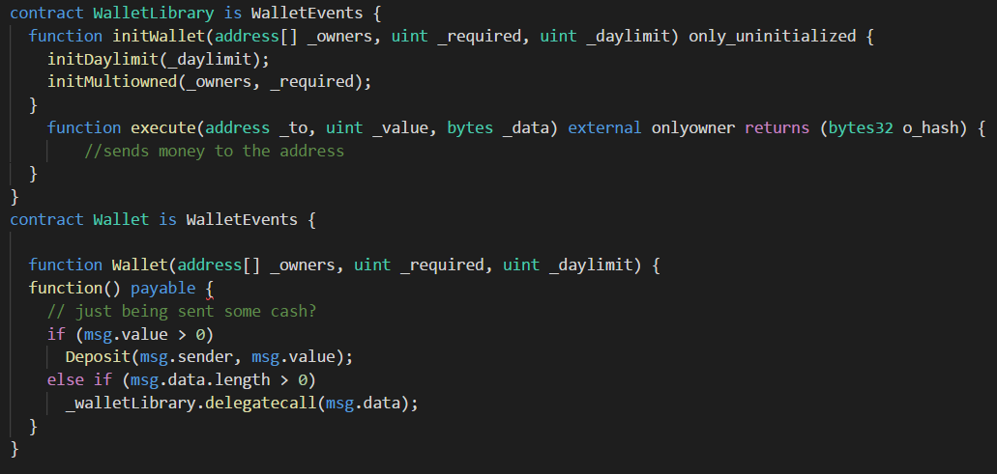
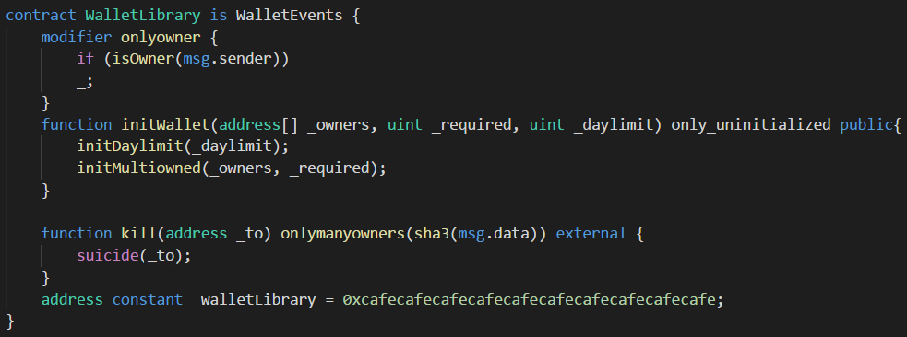
Parity Wallet attacks
Bad coding left them vulnerable to attacks on two occasions
Notes:
1st attack: $150m
2nd Attack: $31 million
In the first example, vulnerability is delegatecall, which gives full power of the contract to another person.
In this case, notice that the execute function has no require(), so anyone can call the execute function and send money
In the second example, people did not realise that the walletLibrary is technically a Wallet as well, and hence it was never initialized. So one person initWallet the library and killed it.

Slide 81
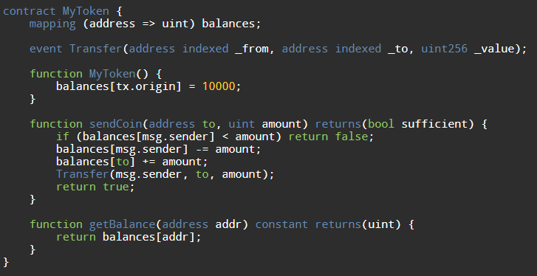
Short Address Attack
The fault here lies in the way EVM handles underflows, it pads it with 0s
00000000000000000000000062bec9abe373123b9b635b75608f94eb86441630
000000000000000000000000000000000000000000000000000000000000002
00000000000000000000000062bec9abe373123b9b635b75608f94eb8644163
0000000000000000000000000000000000000000000000000000000000000002
00000000000000000000000062bec9abe373123b9b635b75608f94eb86441630
0000000000000000000000000000000000000000000000000000000000000002
00000000000000000000000062bec9abe373123b9b635b75608f94eb86441630
0000000000000000000000000000000000000000000000000000000000000020
2<<4 = 32 coins
= 30 new coins
0x62bec9abe373123b9b635b75608f94eb86441630
2

Slide 82
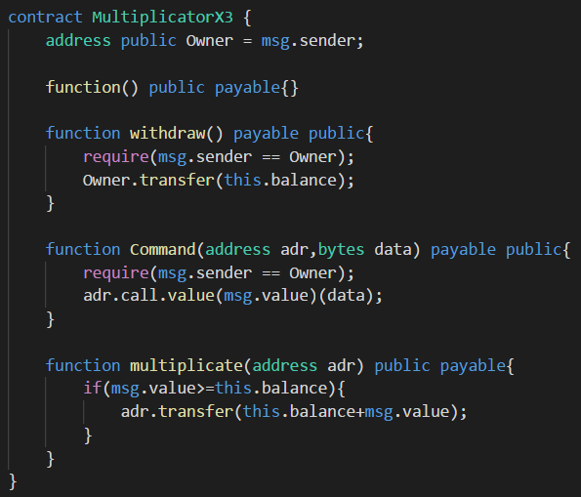
Honeypots
this.balance is updated before the multiplicate method is called
Hence, (msg.value>=this.balance) will always be false and transfer will not run (unless initial balance is 0)

Slide 83
Lesson structure
Dapp Architecture
Blockchain Architecture
Dapp
Security
Blockchain Security

Slide 84
Blockchain Security

Slide 85
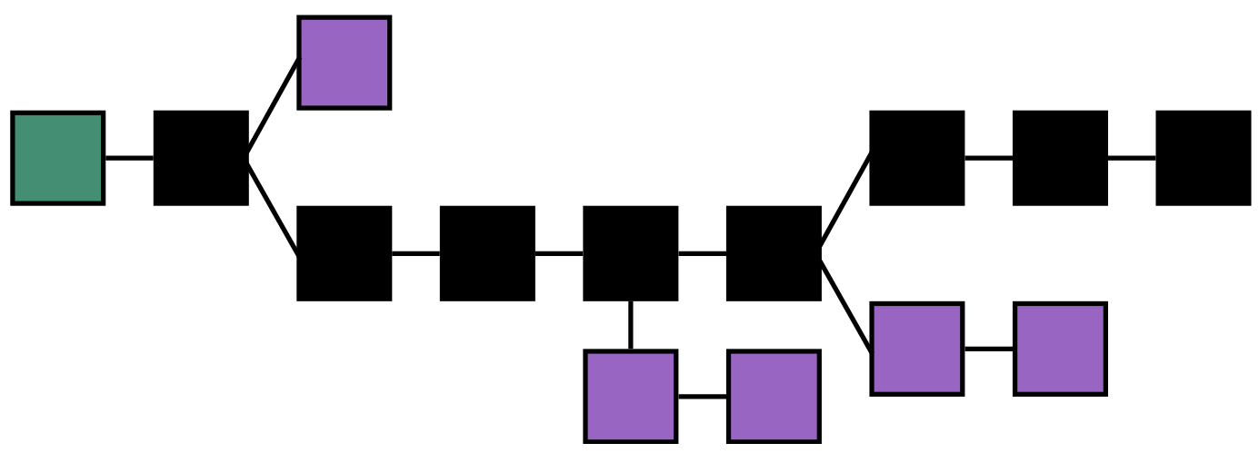
51% Attack (Proof of Work)
Blocks are validated through mining, which is dependent on hashing power

Slide 86
Long Range Attack (Proof of Stake)
Blocks are validated through validators, which is dependent on wealth (amount staked)
Notes:
Weak Subjectivity
Costless Simulation
Mitigation:
Longest Chain rule + moving checkpoints
Doesn’t cover short range attacks, but that’s a different story
Key-Evolving Cryptography
Prevent Posterior corruption
Context-aware Transactions
Prevent wholesale copying of transactions
Plenitude Rule
Block density of branch
Identifies fake branches fast

Slide 87
Transaction (sig) Malleability
Broadcasting the same transaction signature with a modified transaction hash
Sometimes, transaction signatures do not encompass all data in the transaction
Possible to malform transaction hash without invalidating transaction signature
Requires broadcast before confirmation of transaction into a valid block
Possible to malform transaction hashes by
Modifying minor details (whitespaces or paddings)
Using complementary signatures of certain cryptographic signature schemes (ECDSA)
Major transaction details like recipients and value remains unchanged
This transaction, if confirmed over the other original, will trick the sender to think the transaction failed when it actually succeeded
Senders query using their transaction hashes
Which is invalidated due to the modified, fraudulent transaction
Can lead to double-spending
Notes:
Attacker can wait for transactions to be made and quickly echo the transactions with modified data.
Network latency and other system factors gives this a real chance of happening.
Actually happened in the Mt Gox hack (or so they claimed), stealing 844,408 BTC (744,408 from customers, 100,00 from Mt Gox)
Solved with SegWit

Slide 88
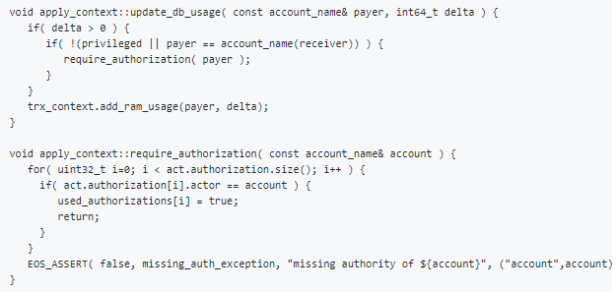
Denial of Service – System level
EOS RAM Hijack
EOS uses RAM to execute and store state of smart contracts
Smart contracts can notify others about specific events, such as token transfer
If recipient is a contract, does not check if action is authorized by action handler → RAM consumed
Can potentially fill action handler’s RAM with garbage notifications, thus using up all bandwidth to process contracts
Notes:
EOS RAM is a more complicated concept. It does not precisely correspond to the RAM concept in computer science. Simply put, it is all the resources used except CPU and bandwidth in EOS, roughly corresponding to RAM and database in computer science sense.

Slide 89
BFT Consensus algorithms forking
In BFT type algorithms, Blocks require 66% consensus on transaction validity
NEO Blockchain
Initially used a 2-phase protocol for efficiency and lower complexity
Missed the “commit” phase of traditional BFT algos
Uniformity of message “Proposed blocks” is not agreed upon
Led to different blocks formed on the blockchain → Fork
Caused ensuing blocks to record different previous hashes
Consensus cannot be agreed upon and stalled
Notes:
Solved by including 3rd phase “Commit”

Slide 90
TEE-based consensus
Proof of Elapsed Time (Intel’s Hyperledger Sawtooth)
Based on Intel Software Guard eXtensions (Intel SGX)
Utilises Trusted Execution Environments to generate randomness
Data is protected from even malicious or hacked kernels
Speculative Execution
Microarchitecturally, processor might speculatively guess values from memory
Faulty guesses disturbs other parts of the processor like the cache contents
Speculative Execution detects and measures such disturbances to infer in-memory values
Meltdown, Spectre, Foreshadow

Slide 91


If the Smart contract and Blockchain infrastructure are secure
Is there no other way we can attack the blockchain?

Slide 92
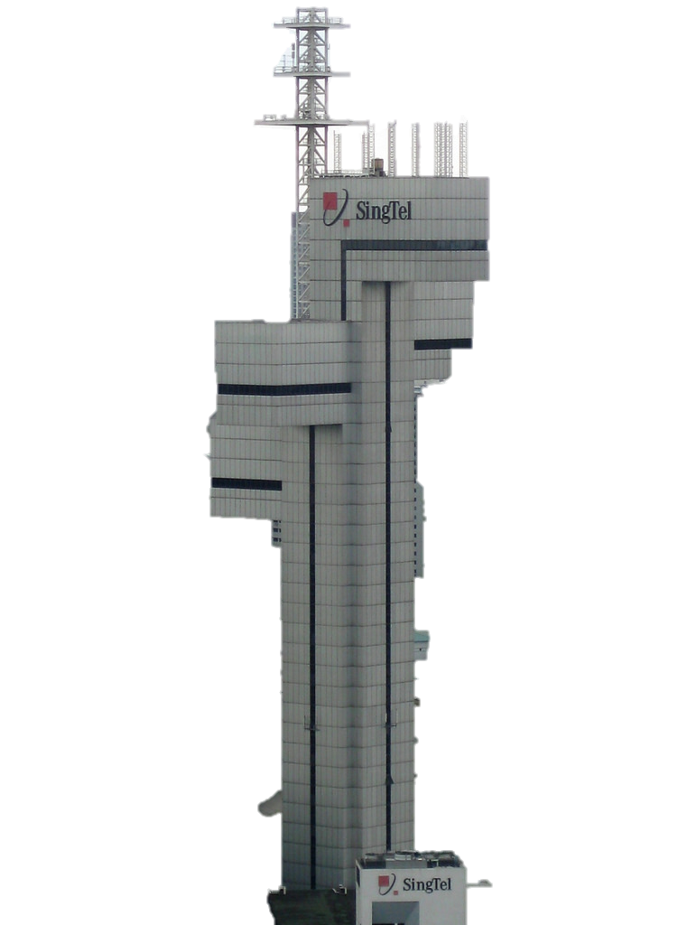


Answer: Blockchain ultimately relies on networks to communicate and gain consensus
That is our attack vector

Slide 93
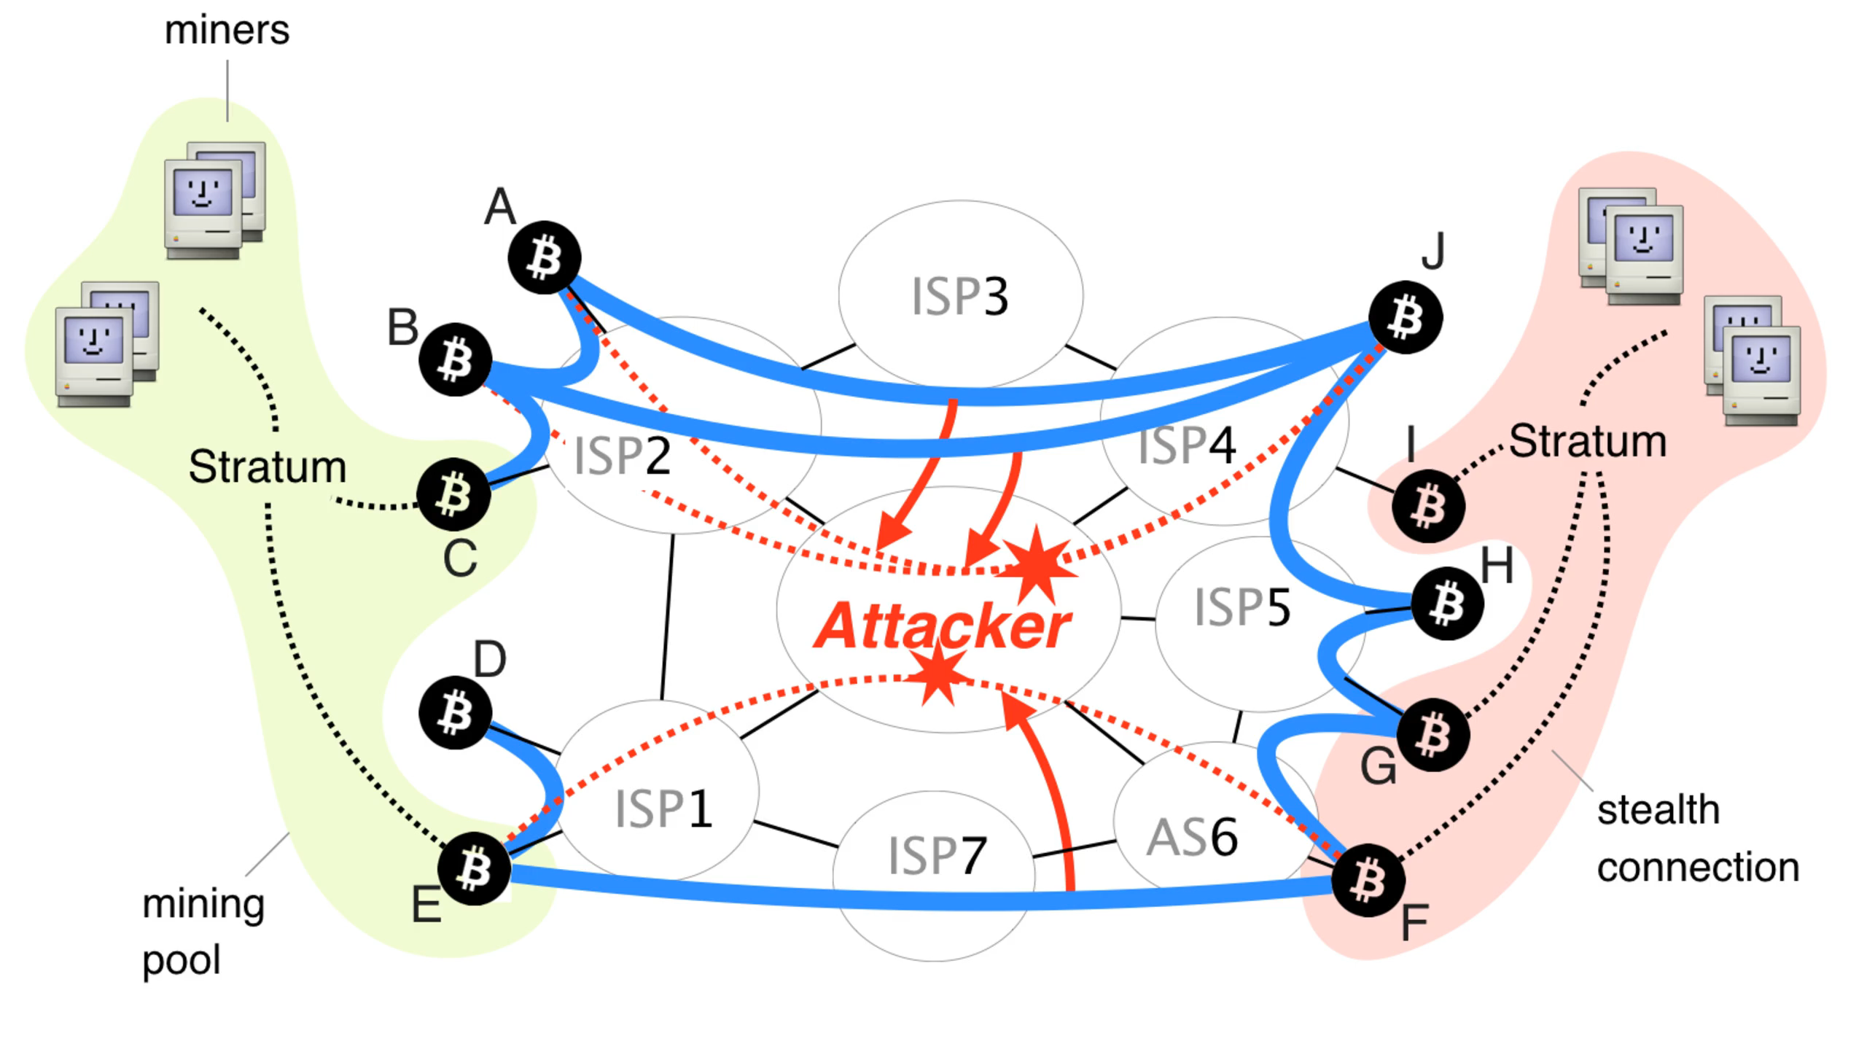
Partitioning Attack
Nodes are reliant on incoming communication from other nodes
Bitcoin has 8 connections, Ethereum has 13
If communication from nodes are malicious, can influence data recorded
If executed on large enough scale, can partition entire networks
Requires hijacking of Autonomous Systems (AS) or Border Gateway Protocol (BGP)
AS contains the information sent out
BGP determines the routing of information
Notes:
13 ISPs (0.026%) host 30% of BTC network
3 ISPs can view 60% of BTC traffic
By preventing nodes within a component to communicate with nodes outside of it, the attacker forces the creation of parallel blockchains. After the attack stops, all blocks mined within the smaller component will be discarded together with all included transactions and the miners revenue.
Step 0: Nodes of the left and the right side of the network communicate via Bitcoin connections denoted by blue lines.
Step 1: The attacker wishes to split the network into two disjoint components: one on the left hand-side and one on the right hand-side.
Step 2: The attacker attracts the traffic destined to the left nodes by performing a BGP hijack.
Step 3: Soon after the hijack, all traffic sent from the right to the left side is forwarded through the attacker (red lines).
Step 4: The attacker cuts these connections, effectively partitioning the network into two pieces.
Step 5: During the attack, nodes within each side continue communicating with nodes of the same side

Slide 94
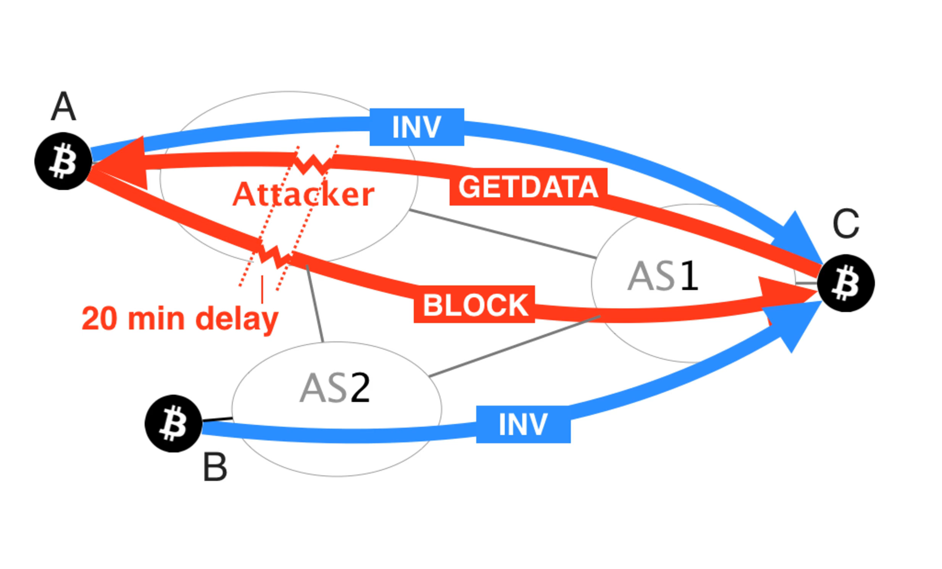
Delay Attack
Can delay delivery of block up to 20 minutes
Victim unaware of most recently mined block and its corresponding transactions
Double Spending attack
Wasteful mining
Notes:
Step 0: Nodes A and B advertise the same block to the victim, node C.
Step 1: Node C requests the block via a GETDATA from node A. The attacker changes the content of the GETDATA such that it triggers the delivery of an older block from node A.
Step 2: The older block is delivered.
Step 3: Shortly before 20 minutes after the original block request made by node C, the attacker triggers its delivery by modifying another GETDATA message originated by C.
Step 4: The block is delivered just before the 20 minutes timeout. The victim does not disconnect from node A.
Already affecting BTC network! In 2015 November, 8% (447 nodes) of all BTC nodes were hijacked. Now, at least 100 BTC nodes are victims of BGP hijacks per month.

Slide 95
Questions?
Just ask don’t shy

